Slide 1
The Future of Money

Slide 2
About us
The Future of Money
To be pioneer in providing worldwide , multi jurisdictions ,regulated, secure , customer centric, user friendly and most trusted Crypto currency Exchange platform and NFT Marketplace.
To be one stop solutions for early stage investor to a hard core professional trader , with access to most sophisticated trading tools
To be most secured payment , settlement , wallet and custodian service provider

Slide 3
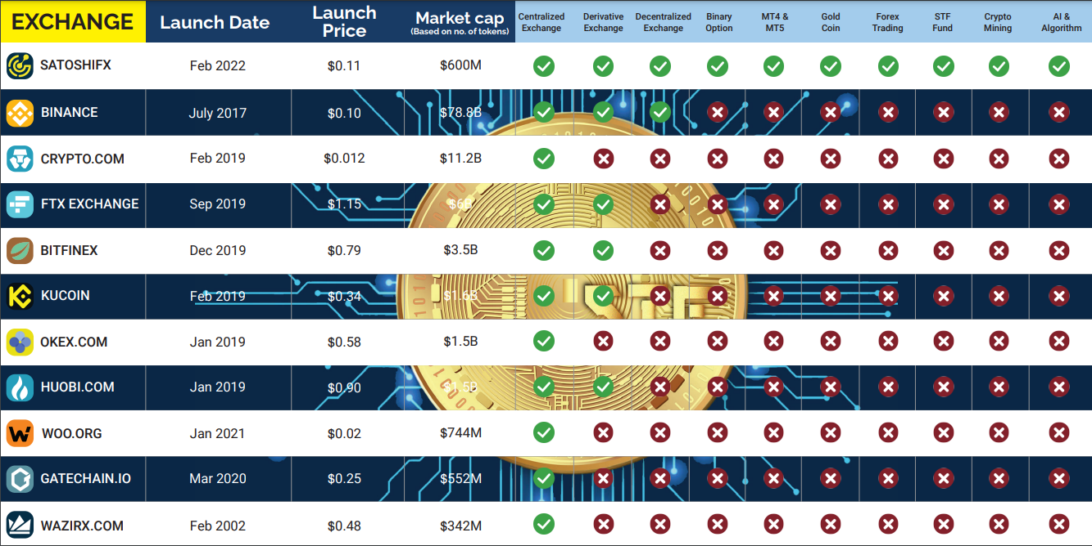
COMPARISON CHART

Slide 4
Vision
The Future of Money
SatoshiFx will be a world leader in creating an eco system for Crypto & Forex Investment and trading with Educational tools backed with a call centre.
Aim
SatoshiFx aims is to create high value and best ROI for Investors and stake holder
Future of Money
To expand and grow together with all stakeholders, Investors and everyone in the ecosystem , with continues Innovation

Slide 5
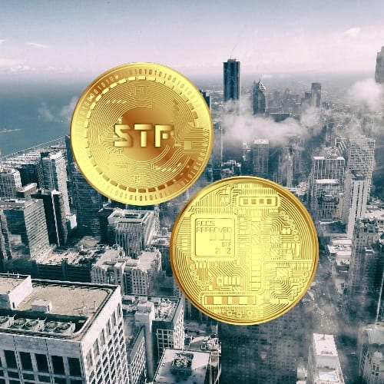
Best in class platform
The Future of Money
We are the only platform with
Centralized, Decentralized & Derivative Exchange
Gold & Silver coins
Cold wallet
Crypto Mining Farm
MT4 and MT5 trading tools
A complete Eco-System for Metaverse , Crypto currency & Forex

Slide 6
The Best in Class Exchange
Trustworthy
Secure
Legally recognized
Popular
Transparent
User Friendly
Practice highest level AML and KYC Protocol
Customer centric Approach , 24/7 Customer Care
Competitive Pricing
High Liquidity
Multiple Banks and currency transaction options

Slide 7
1
Crypto Mining
The Future of Money
3
All ALT coins
Investment
Channels
4
MetaQuote Software & Algorithm and Auto Trade
Liquidity
2

Slide 8
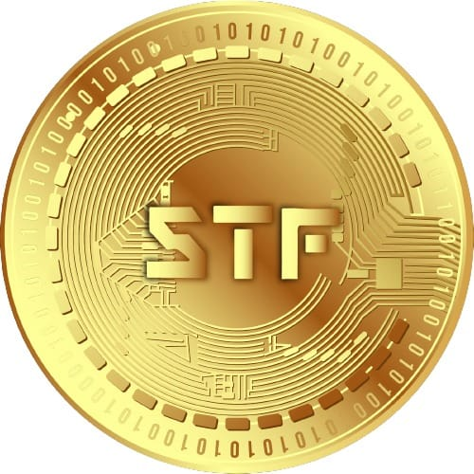
Why choose us?
The Future of Money
Best Track record in the UAE
45 yrs of exceptional Business
Business of over 40 Billion turnover
ZERO defaults in business transactions
Highly experienced team of Entrepreneurs, Multibillionaires & Executives of TOP world class companies.

Slide 9
Features
The Future of Money
Centralized Exchange
Decentralized Exchange
Derivative Exchange
Binary Options
MT4 & MT 5
Gold coin
Forex Trading
STF Fund
Crypto Mining
AI & Algorithms
MetaVerse

Slide 10
Meta Trader
The Future of Money
A TRUE GAME CHANGER!!
Non-Hackable first of its kind platform developed

Slide 11
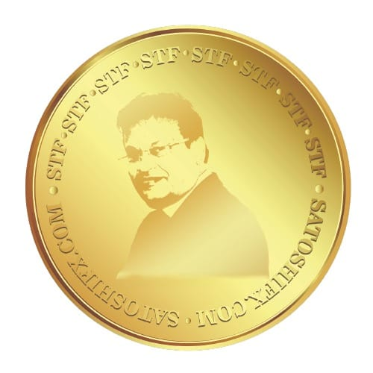
STF - Gold Coin
Based on 40 years of experience in the industry, everyone will understand in due course
First of a kind of introduction, where the investor will never loose money.
Investors and associates can keep making money all year around

Slide 12
The Future of Money
Example: Investment of 7000$
Proportionate value from 7000$ upto an unlimited amount
24 Karat STF gold coin, with value of 90-93%
10%
STF Digital Coin
STF Digital coin, with value of 10% at current price of that day.
Example: If its 40cents, you will receive 10% of investment viz; upto 200$ divided by 40cents which gives you 500 coins.
Amount is subject to daily market changes (min of 40cents)
91-93%
STF - 24 Karat Gold coins
Free All Educational videos
Free Digital Education material
Free Cold Wallet for storage of BitCoin
News on website and daily updates
We expect the gold & STF price to go up
Highlights:

Slide 13
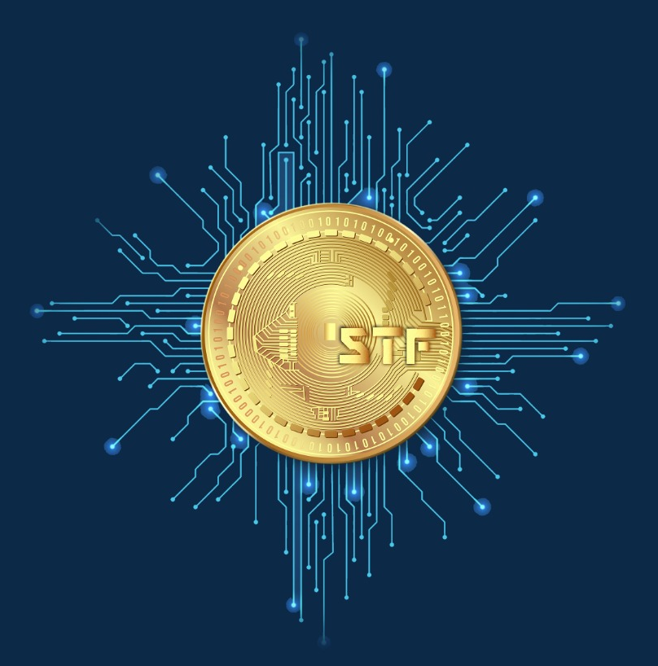
BELIEVE!!
STF
BTC If believe at 0.5 cents imagine now 68000Bn
If believe at .10 Now - 780
Same way STF see the system and plan
Then gold we put together not a single client to lose

Slide 14
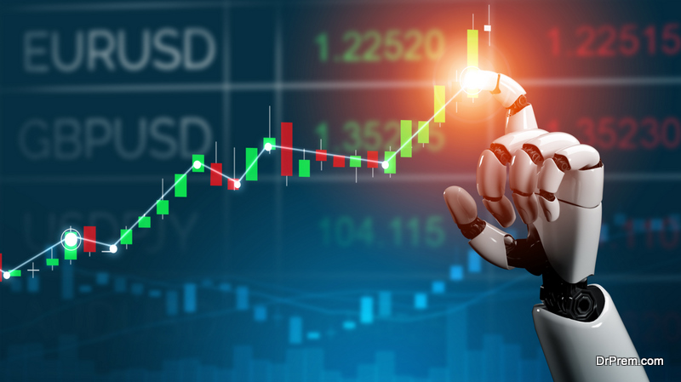
Algo and Auto trading facilities
Super advantage to clients
We developed abs association with world best algorithms
Developed to benefit clients

Slide 15
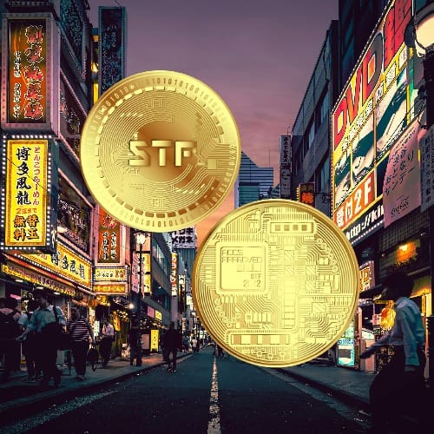
The Future of Money
A Responsible Leader With Worldwide Market Recognition
SatoshiFx Assets is the leader in the alternative assets market.
First company in the Middle East to hold a comprehensive crypto license.
Only company in the industry for 10 years that boasts 0 complaints and 5 star ratings on the Better Business Bureau (BBB), The Business Consumer Alliance (BCA) and TrustLink.
Satoshifx Assets has had a lot of invaluable celebrity endorsements, such as from Dennis Miller, Laura Ingraham and Larson.
Notes:
Forbes and midday

Slide 16
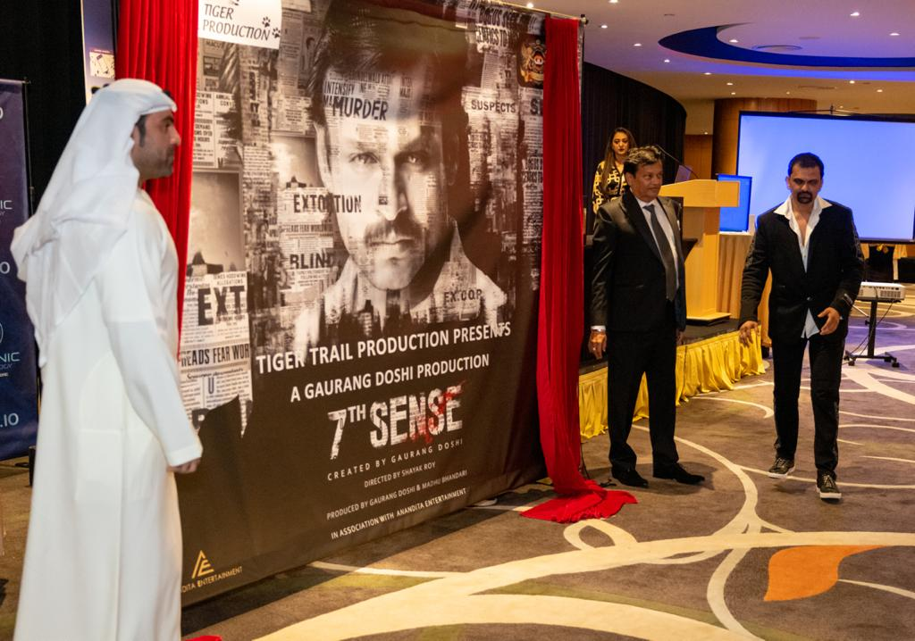
The Future of Money
BRANDING- Hollywood & Bollywood
Spending Millions of USD on branding
Branding of STF coin in Hollywood and Bollywood
Credible and popular celebrities included in the Branding programs all year around.
Famous personality event branding
Notes:
Forbes and midday

Slide 17
The Future of Money
Smart Investments
Smart investments open up new arenas for profit generation and strength the market value of Satoshifx.
New Alt Coins
Own Block Chain Development
New Alt coins will be generated giving more liquidity
Plans to develop our own Block chain technology in the future.

Slide 18
Create an International Crypto Currency Education System, Block chain projects and NFT development & marketplace
The Future of Money
1
SatoshiFx
The Road Ahead
Positioned as the largest International trading platform for Cryptos and Forex . To be market leader in Cypto Mining and NFT
2
3
SATOSHIFX to go public in 3 Year , to be listed on NASDAQ

Slide 19
Connect with us
+971 55 678 1111 +971 4 432 2209
www.satoshifx.io / www.satoshifx.com
Office 1006, 10th Floor, Sobha Ivory 2 building, Business Bay, PO 102659, Dubai, UAE
Churchill tower, Business bay, Dubai
JLT, HDS Tower, Dubai

Slide 20
Plans of opening 10 Offices Worldwide
Office Opened
Offices on the way
India
Dubai
USA
South Korea
South Africa
Saudi Arabia
Kuwait
Egypt

Slide 21
THANK YOU
The Future of Money

